Slide 1

Green
Arrow
Sujan Aryal, Anurag Baral, Julian Fung, Harsha Madduri

Slide 2
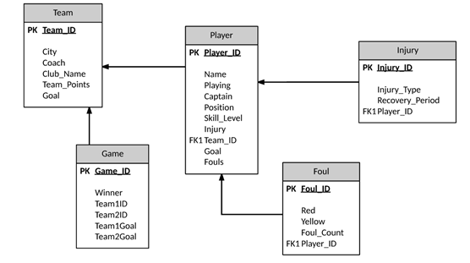
Database Schema - Soccer League
Notes:
Julian

Slide 3
Normalization
Schema designed was already in 2NF
Made assumptions to Normalize to 3NF
Notes:
Julian

Slide 4
Use Cases
Show all players of a team
Teams standing for the season
View Player details
View Game details
View Game schedules
Search MVP of league
Notes:
Julian

Slide 5
Database generation
Used Mockaroo to generate random data
Could only export 200,000 data per day
Duplicated data to reach 1.5 million entries
Exported into CSV format to import into MySql and MongoDB
Notes:
Aryal

Slide 6


Database population
MySql
MySql workbench to import data from file from csv format
MongoDB
MongoChef to import data from file with csv format
Notes:
Aryal

Slide 7
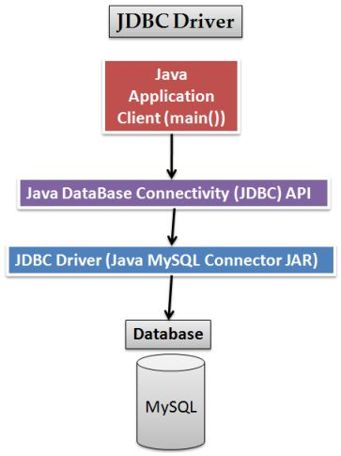
Java Front End for MySql and MongoDB
MySQL
Mongo
Notes:
Aryal

Slide 8
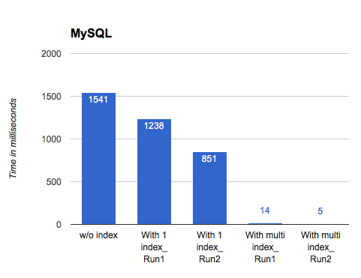
SQL Graph Analysis
Query on database with :
No index
Unique Index
Composite Index
Notes:
Harsha

Slide 9
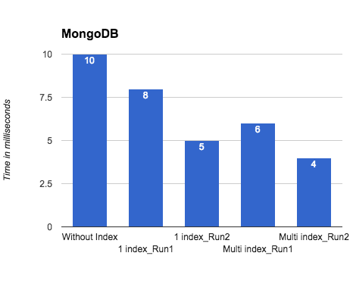
MongoDB Graph Analysis
Query on collection with:
No index
Single Field Index
Compound Index
Notes:
Harsha

Slide 10
SQL vs MongoDB
Notes:
Harsha

Slide 11
Challenges Faced
Populating database
Accessing SQL and Mongo from Java
Defining multiple indexes
Normalization
Notes:
Anurag

Slide 12
Team member contributions
Populating databases - All
Accessing SQL and Mongo database from Java - Sujan, Anurag
Defining indexes - Julian, Harsha
Creating and analyzing graphs - Harsha, Sujan
Prepared/consolidated submission documents - Julian
Notes:
Baral

Slide 13
Questions

